Slide 1



Video Conferencing Application With Speech Transcription
Capstone Project Phase I
Project Number 24-1-D-19
By:
Rami Amasha
Moayad Hamza
Supervisor:
Mr. Ronen Zilber
Email: rzilberl@gmail.com
1

Slide 2
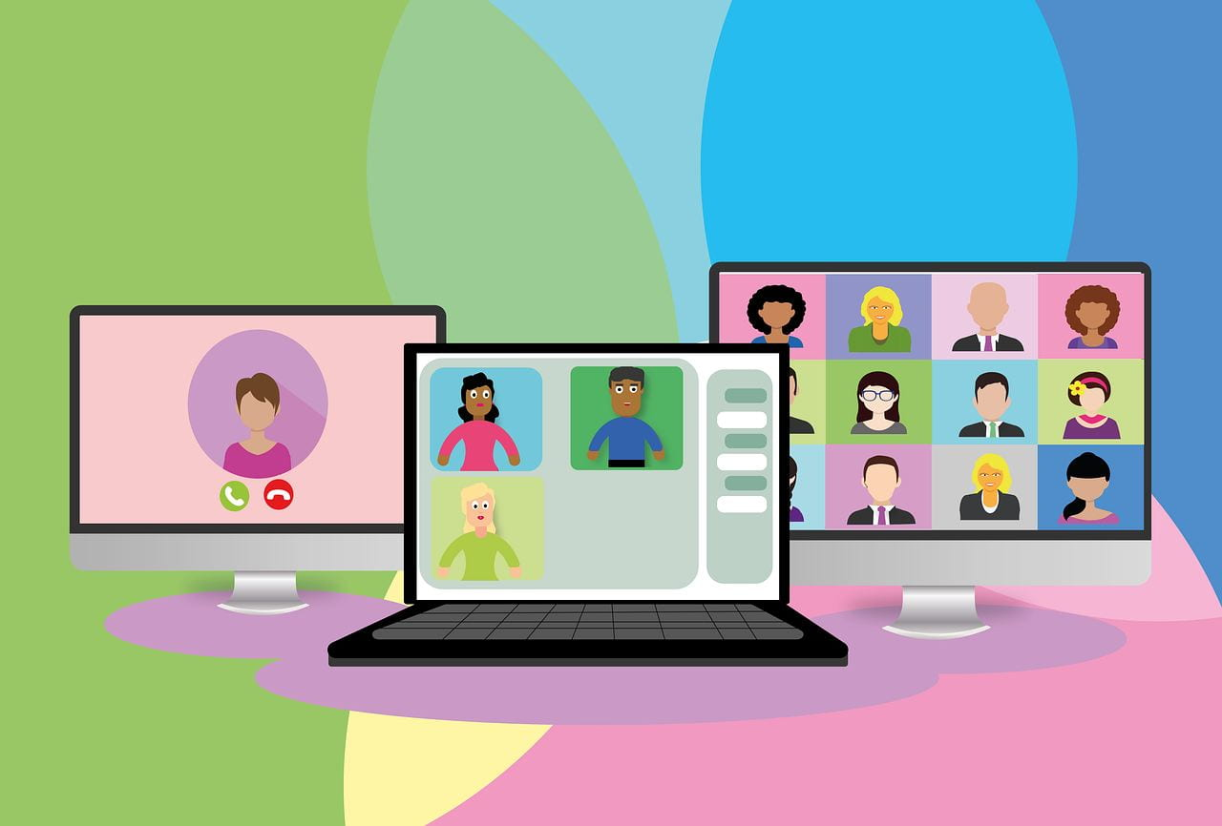

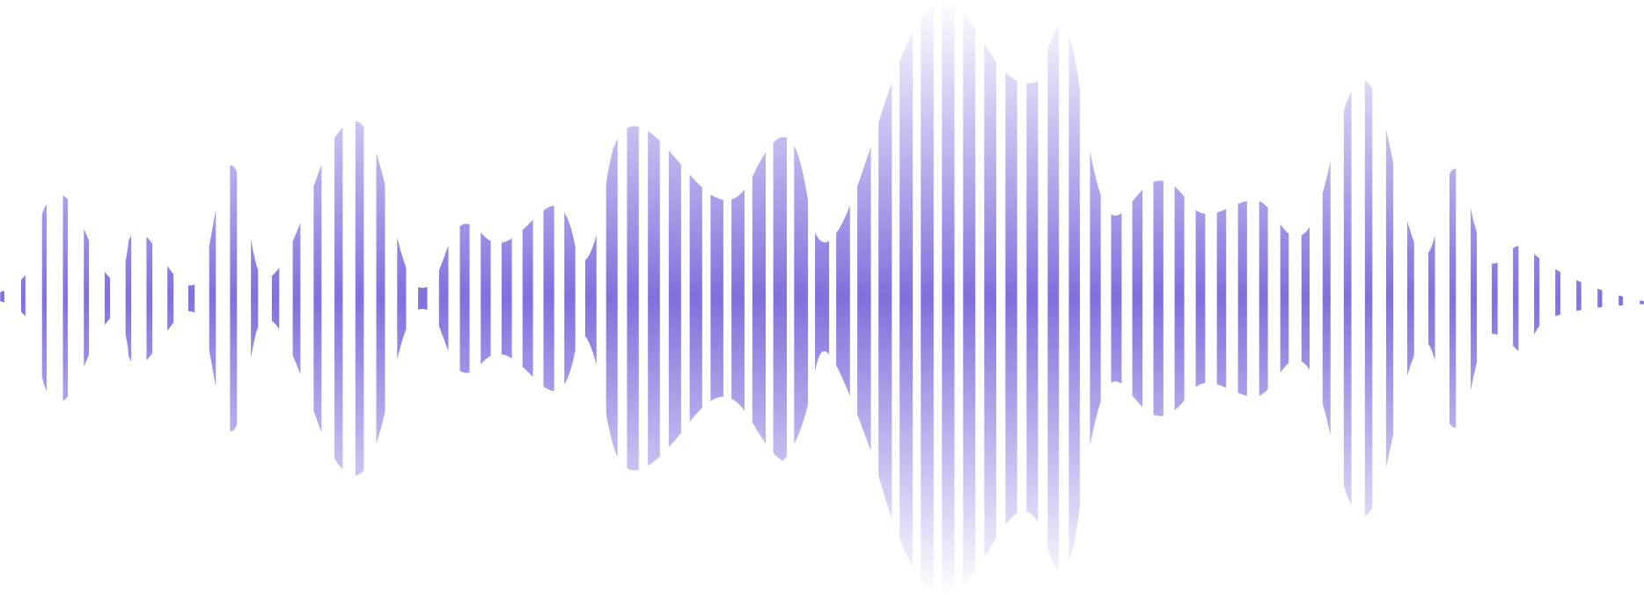
Introduction
After COVID-19, remote conference became more and more popular, but until now all the applications don't have the ability to save the transcript of the conference .
תמונה זו מאת מחבר לא ידוע ניתן ברשיון במסגרת CC BY-SA-NC
2

Slide 3
Motivation
How does speech recognition technology impact communication and accessibility for handicapped and people with hearing impairments?
Identfying current limitations in current speech recognition systems.
3

Slide 4
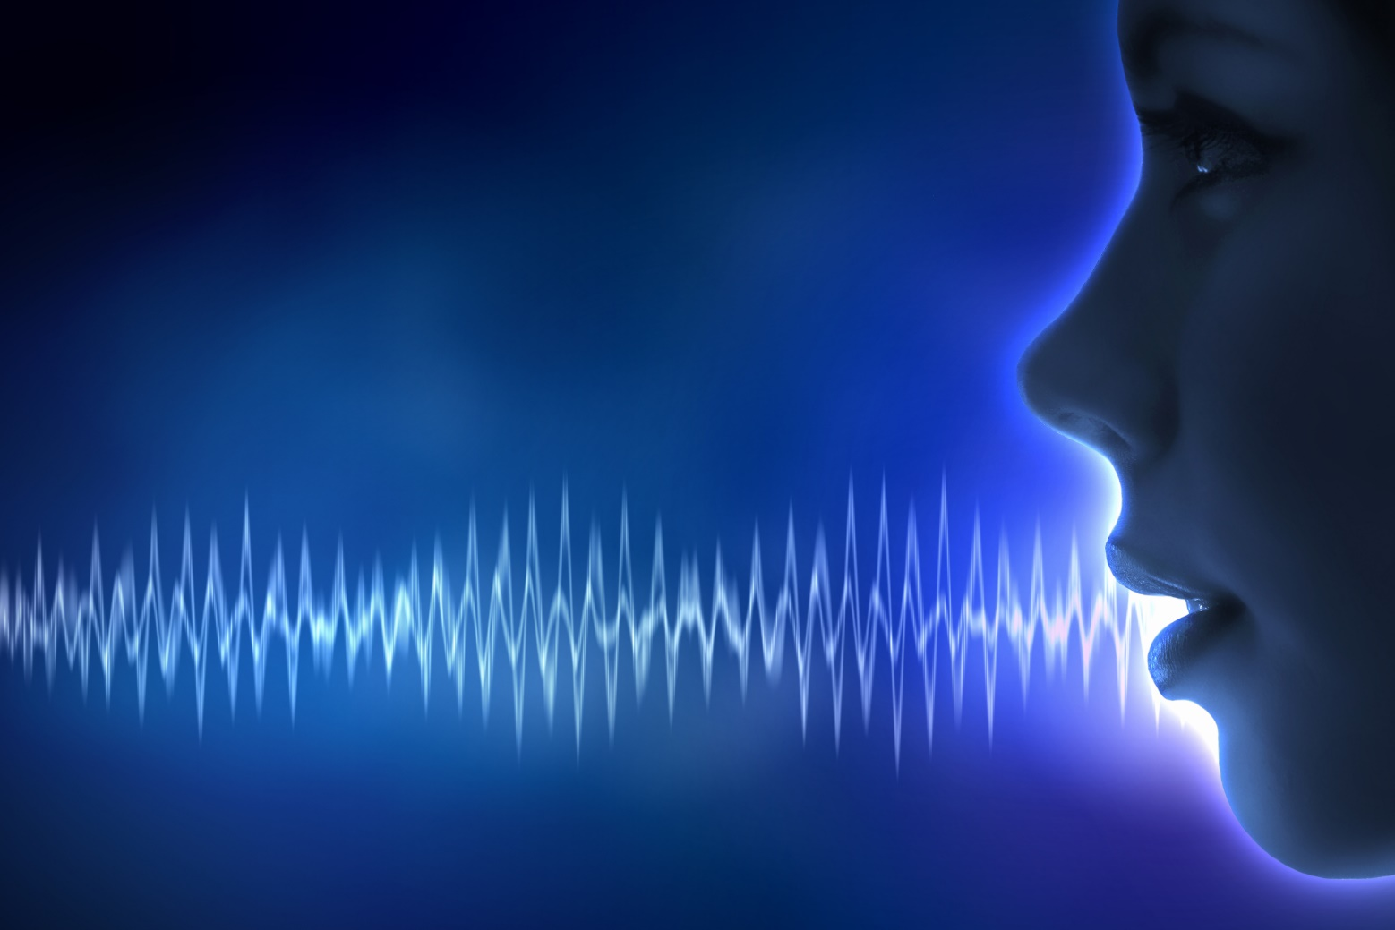
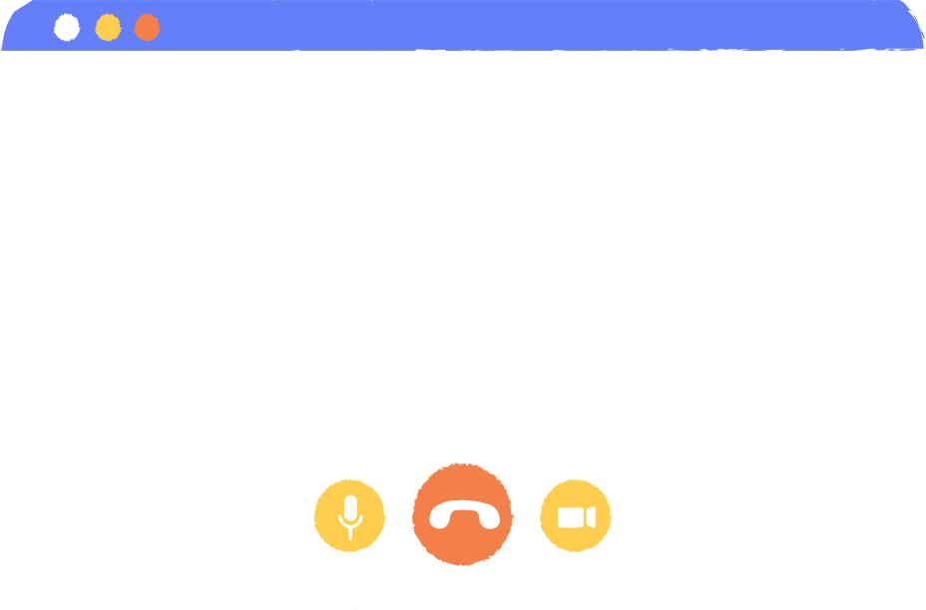


Project Goal
Developing Video Chat Application, that provides a transcript of the spoken content at the end of the Video Chat session.
4

Slide 5

Speech Recognition Problems
Background Noise
Accents and Dialects
Multiple Speakers
Computational Limitations
Limited Training Data
5

Slide 6


Technologies
Various Speech-To-Text Algorithms are used for different needs; some are basic, and some are more advanced.
Hidden Markov Models (HMMs) and Gaussian Mixture Models (GMMs).
Recurrent Neural Networks (RNNs).
Transformers.
Conformers. (we used AssemblyAi api for transcriptiong the audio and stream.io sdk for video chatting)
6

Slide 7
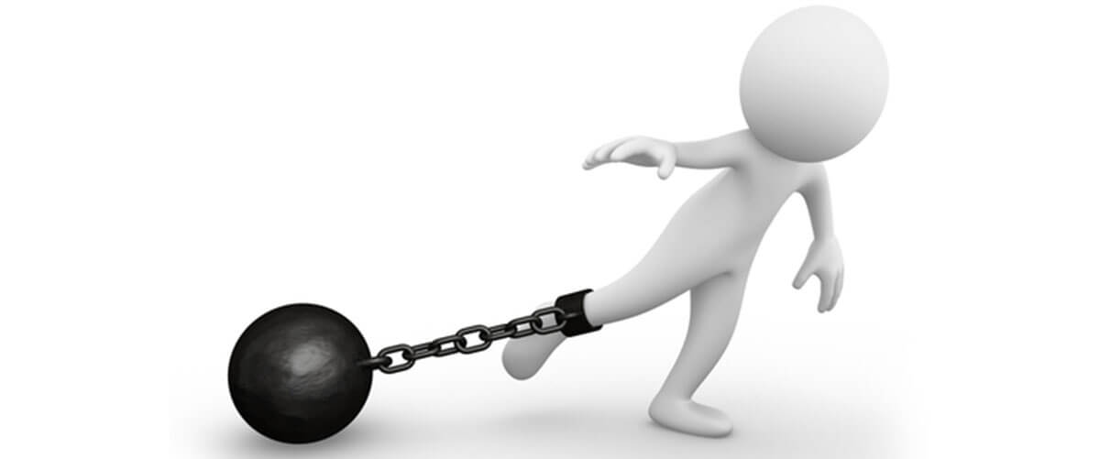



The Process - Constraints
Computational resources.
AssemblyAI- Only English!
Number of participants.
7

Slide 8

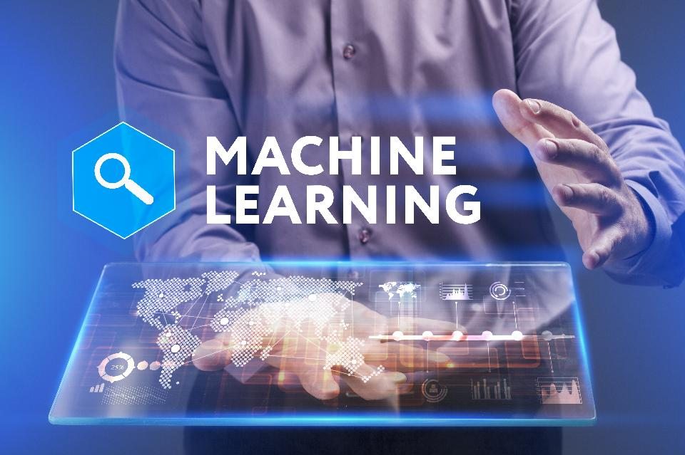
Research
8

Slide 9


Introducing RM-Video Conference
RM is designed to be User-friendly and easy to use.
RM has two main functionalities:
RM
Video-Chat meetings. (Using Stream.io SDK’s)
Transcription.(AssemblyAI -API’s)
RM has the ability to save a transcripted session so user can use later.
9

Slide 10
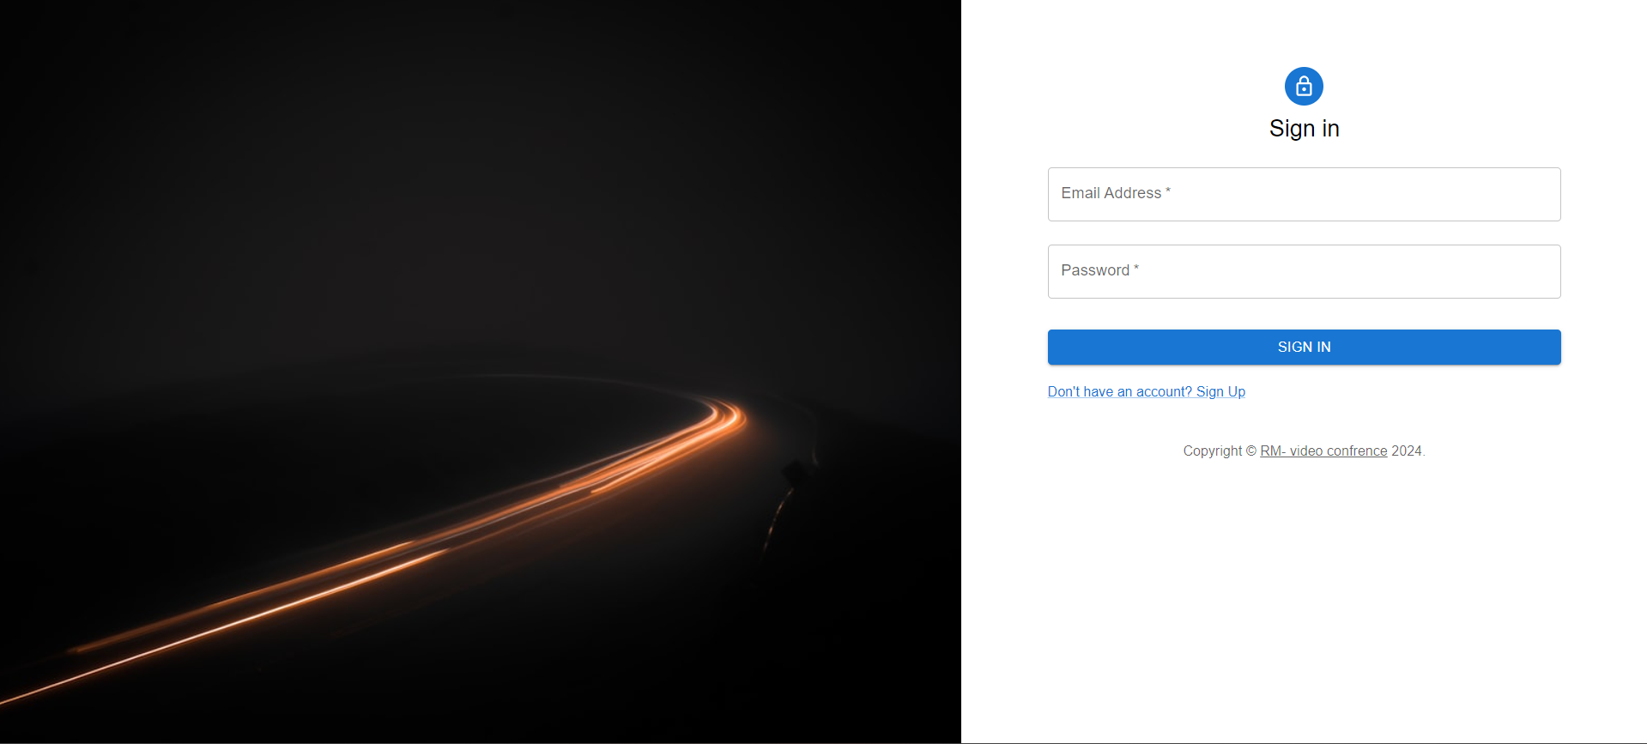
Screens - Login
10

Slide 11
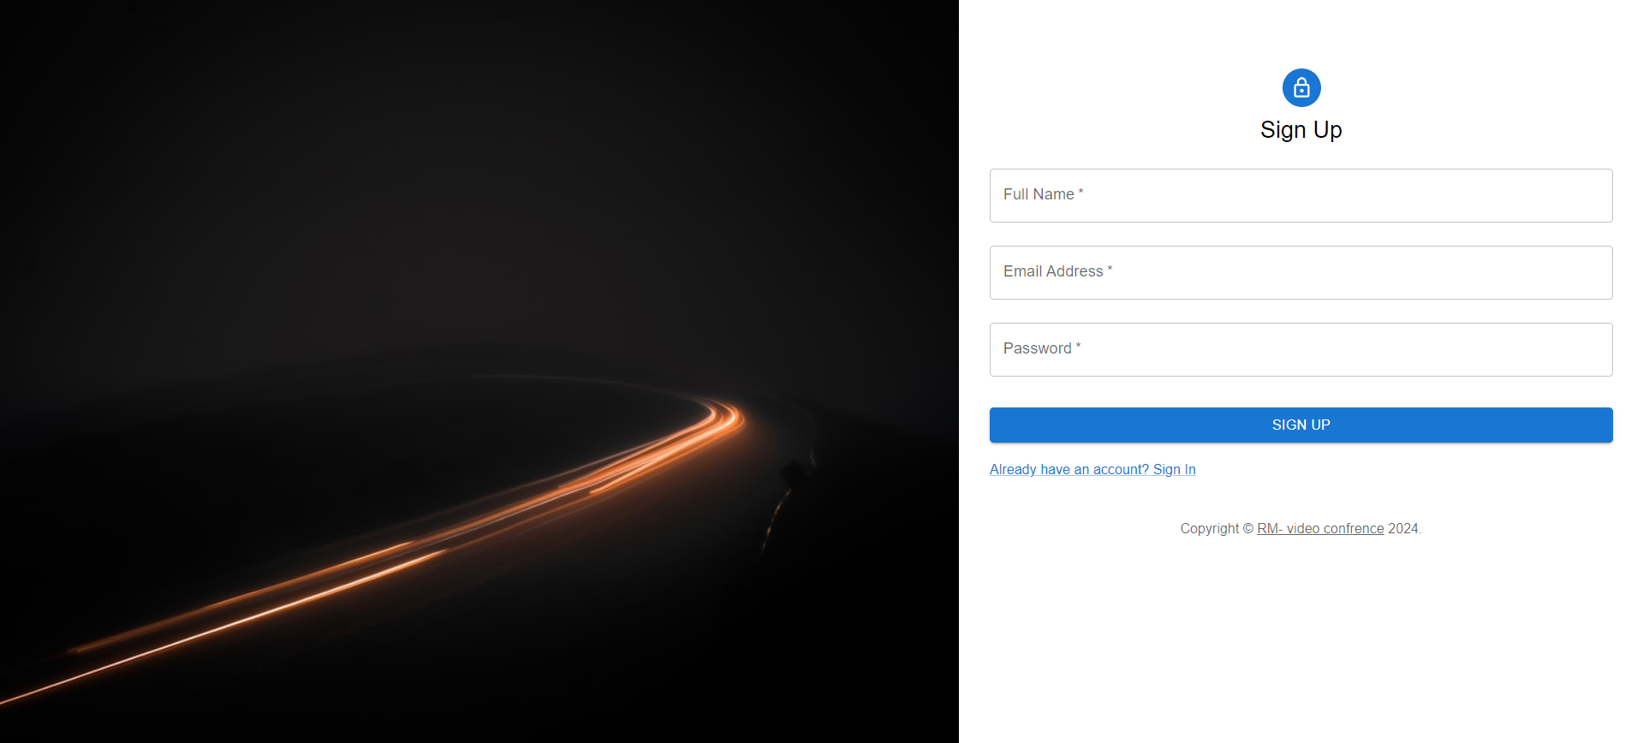
Screens - signup
11

Slide 12
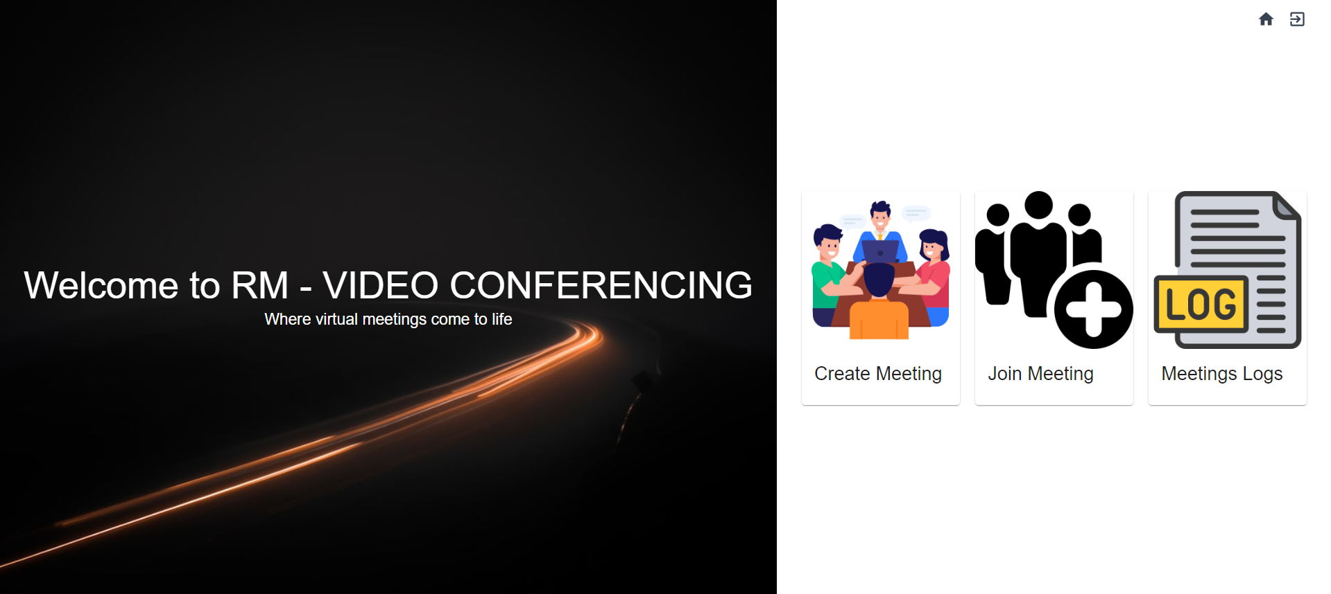
Screens - homepage
12

Slide 13
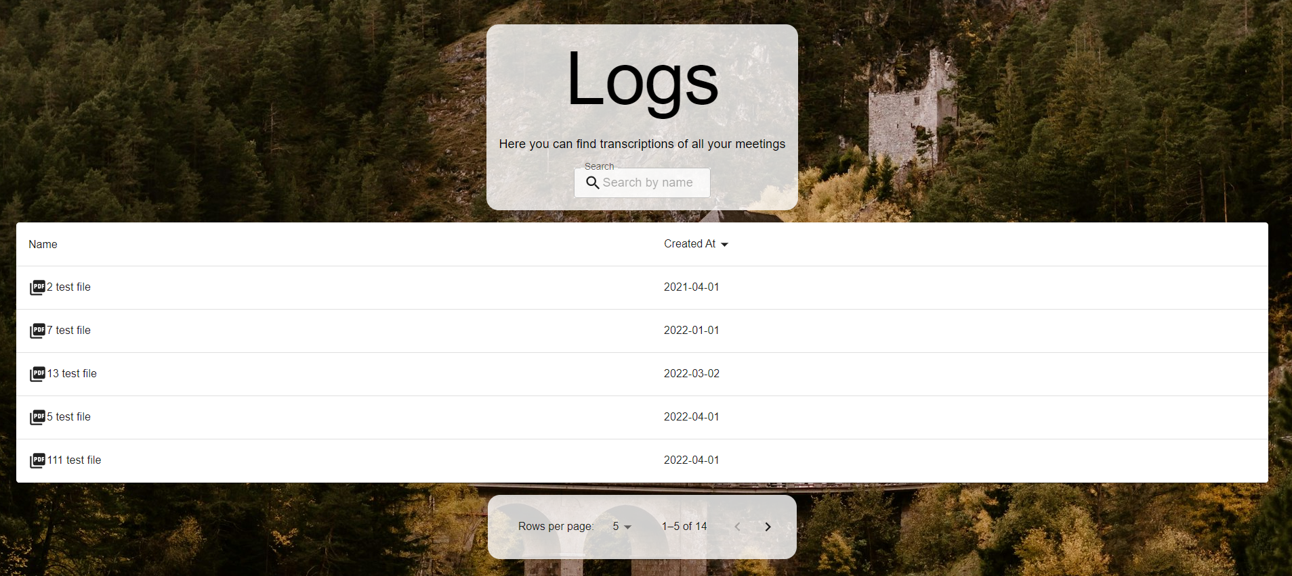
Screens – logs page
13

Slide 14
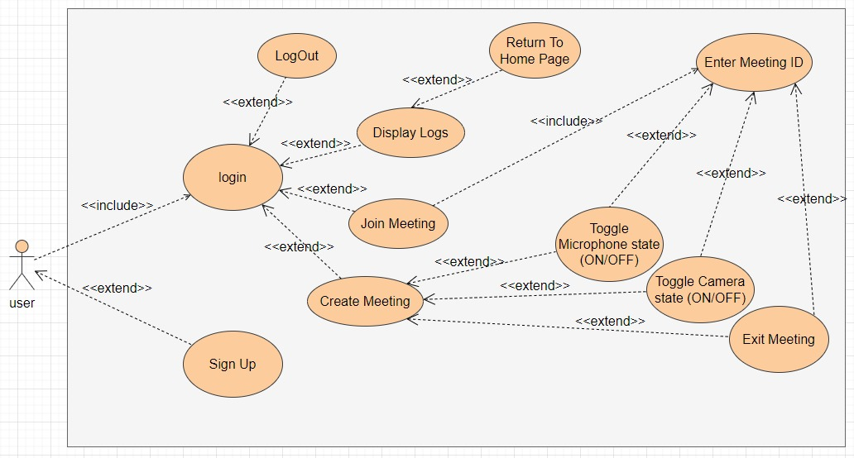
Use Case
14

Slide 15
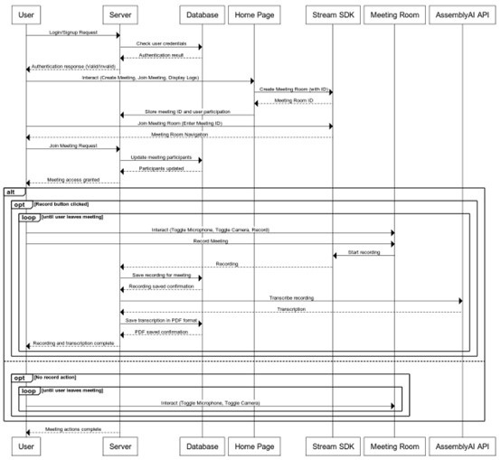
Sequence
Diagram
15

Slide 16
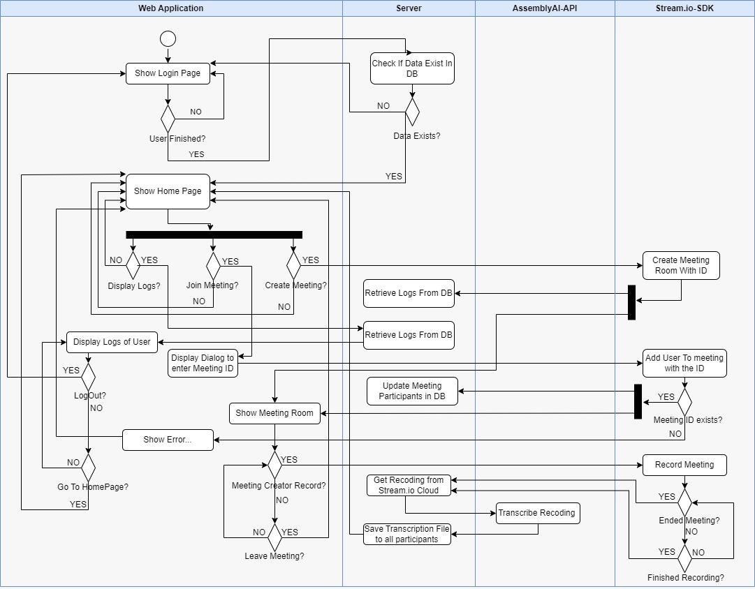
Activity Diagram
16

Slide 17
Testing
We will evaluate our web application based on its ability to capture high quality recordings and sending them appropriately for the assemblyAI API, and writing the transcription to an organized pdf file, also displaying it for all participant in the specific meeting. In addition, for properly using the API to maintain high transcription accuracy.
17

Slide 18
Test | Module | Tested Function | Expected Result
1 | Web application | Page load | First page load<2s
2 | Web application | UI | Responsive and easy to use.
3 | Web application | scalability | Application works perfectly when multiple user are using it simulatinsly.
18

Slide 19
Test | Module | Tested Function | Expected Result
4 | Web application | display meeting | Correctly display the meeting room.
5 | Web application | Join meeting | Display pop out asking for meeting ID.
6 | Web application | Cyber attacks | To block cyber attacks perfectly
19

Slide 20
Thank
you!
23

